Slide 1
Building Web Sites with ASP.NET MVC Framework
Noam King
CTO Sela College
http://blogs.microsoft.co.il/blogs/noam

Slide 2
Agenda
First Steps
Architecture
Forms & Action Filters
Using Ajax & Security
Extending MVC
Q & A
Summary

Slide 3
Why should I care?
    Build applications faster
    Scale easily
    Test better

Slide 4
What is ASP.NET MVC?
A new Web Application Project type
Simply an option
    Not a replacement for WebForms
    Builds on top ASP.NET
    Manual vs Automatic Transmission
Notes:
MGB 2003
© 2003 Microsoft Corporation. All rights reserved.
This presentation is for informational purposes only. Microsoft makes no warranties, express or implied, in this summary.

Slide 5






What is MVC?
Model
View
Controller
Notes:
MGB 2003
© 2003 Microsoft Corporation. All rights reserved.
This presentation is for informational purposes only. Microsoft makes no warranties, express or implied, in this summary.

Slide 6
Separation Of Concerns
Each component has one responsibility
  SRP : Single Responsibility Principle
  DRY : Don’t Repeat Yourself
More easily testable
Helps with concurrent development
Notes:
MGB 2003
© 2003 Microsoft Corporation. All rights reserved.
This presentation is for informational purposes only. Microsoft makes no warranties, express or implied, in this summary.

Slide 7
DEMO
MVC First Steps

Slide 8
What MVC is not ?
Not the new Web Forms 4.0
Not replacing Web Forms, but Adds to it
It can not use Web Controls
Not a whole new engine but sits on ASP.NET engine
Not the best solution for REST

Slide 9

Maintain Clean Separation of Concerns
Extensible and Pluggable
Enable clean URLs and HTML
Great integration within ASP.NET
Tooling Support
Notes:
Microsoft ASP.NET Connections
Updates will be available at http://www.devconnections.com/updates/LasVegas _06/ASP_Connections

Slide 10
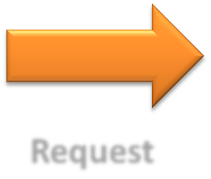
MVC Flow
Controller
Request
Step 1
Incoming request directed to Controller
Notes:
MGB 2003
© 2003 Microsoft Corporation. All rights reserved.
This presentation is for informational purposes only. Microsoft makes no warranties, express or implied, in this summary.

Slide 11


MVC Flow
Controller
Model
Step 2
Controller processes request and forms a data Model
Notes:
MGB 2003
© 2003 Microsoft Corporation. All rights reserved.
This presentation is for informational purposes only. Microsoft makes no warranties, express or implied, in this summary.

Slide 12

MVC Flow
Controller
View
Step 3
Model is passed to View
Notes:
MGB 2003
© 2003 Microsoft Corporation. All rights reserved.
This presentation is for informational purposes only. Microsoft makes no warranties, express or implied, in this summary.

Slide 13


MVC Flow
Controller
View
Step 4
View transforms Model into appropriate output format
Notes:
MGB 2003
© 2003 Microsoft Corporation. All rights reserved.
This presentation is for informational purposes only. Microsoft makes no warranties, express or implied, in this summary.

Slide 14
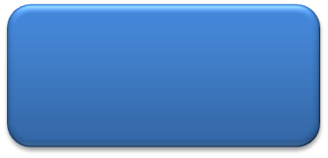
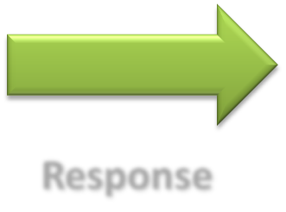
MVC Flow
Controller
View
Response
Step 5
Response is rendered
Notes:
MGB 2003
© 2003 Microsoft Corporation. All rights reserved.
This presentation is for informational purposes only. Microsoft makes no warranties, express or implied, in this summary.

Slide 15

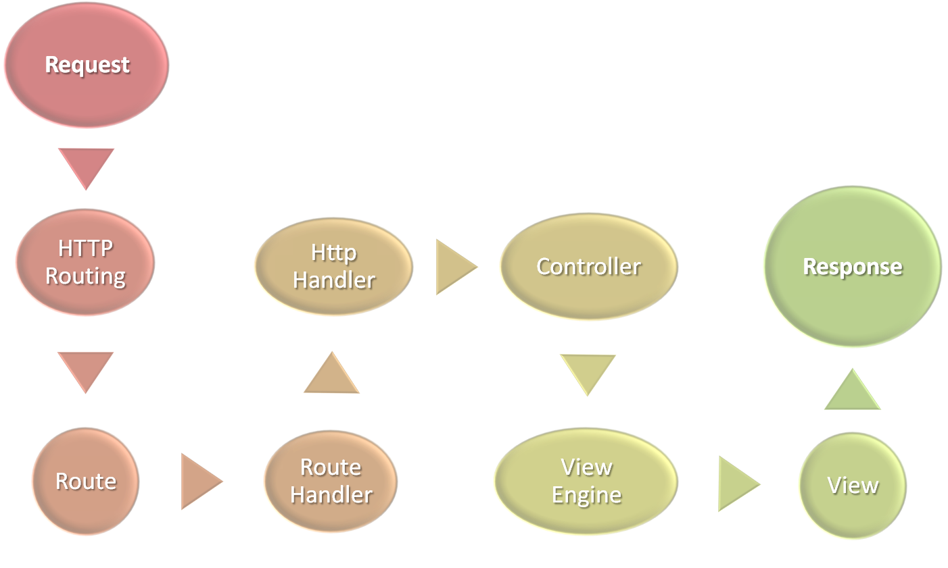
Notes:
Microsoft ASP.NET Connections
Updates will be available at http://www.devconnections.com/updates/LasVegas _06/ASP_Connections

Slide 16
Routing Engine
URLs -> application -> Controller Action
Construct outgoing URLs
  Constructed URLs can be used to call back to Controllers/Actions
Notes:
Microsoft ASP.NET Connections
Updates will be available at http://www.devconnections.com/updates/LasVegas _06/ASP_Connections

Slide 17
DEMO
Routing

Slide 18
Forms & Action Filters
Inject code interceptors into the request of a MVC controller
Package-up and re-use functionality in a clean declarative way
Predefined Action Filters
Custom Filters
Notes:
Microsoft ASP.NET Connections
Updates will be available at http://www.devconnections.com/updates/LasVegas _06/ASP_Connections

Slide 19
DEMO
Forms & Action Filters

Slide 20
Ajax Support
Ajax is not just “Update Panel” ☺
You can use
  Page methods
  Web Services
They all require you to write a lot of javascript
MVC Ajax helps with Forms and ActionLinks !!
Notes:
Microsoft ASP.NET Connections
Updates will be available at http://www.devconnections.com/updates/LasVegas _06/ASP_Connections

Slide 21
Security Support
Built in Controller for Logging
Using ASP.NET Security Providers
Having the ability to control the security level of each controller method
Notes:
Microsoft ASP.NET Connections
Updates will be available at http://www.devconnections.com/updates/LasVegas _06/ASP_Connections

Slide 22
DEMO
Ajax & Security Support

Slide 23
Extensible
Replace Any Part with one of your own
As simple or complex as it needs to be to suit your tasks
Plays well with others
  Want to use NHibernate for models? OK!
  Want to use Brail for views? OK!
  Want to use VB for controllers? OK!
Notes:
MGB 2003
© 2003 Microsoft Corporation. All rights reserved.
This presentation is for informational purposes only. Microsoft makes no warranties, express or implied, in this summary.

Slide 24
To MVC or not To MVC, That’s the <?/>
MVC | Web Forms
You want full control over markup | You like programming against the reusable control abstraction that encapsulate UI and logic
You want a framework that enforces separation of concerns | You like using the WYSWIG designer and would rather avoid angle brackets
TDD/Unit Testing is a priority for you | You like keeping logic on the server rather than hand writing Javascript
Control abstractions get in your way more than they help | Unit testing with the MVP pattern is sufficient for your needs
You like writing Javascript

Slide 25
Q & A

Slide 26
Summary
Not a replacement for WebForms
  All about alternatives
Fundamental
  Part of the System.Web namespace
  Same team that builds WebForms

Slide 27
Additional Resources
Official sites
  Central landing site: http://asp.net/mvc
  Forums: http://forums.asp.net/1146.aspx
Source available
  Source drop: http://codeplex.com/aspnet
Blogs
  http://blogs.microsoft.co.il/blogs/noam
  http://weblogs.asp.net/scottgu
  http://hanselman.com/
  http://haacked.com/

Slide 28

Related Sessions
DEV401: ASP.NET Ajax Internals
Dan Amiga
09:00-10:30 Arbel Hall
DEV302: Building Your First Great Silverlight 2 Application
Guy Burstein
10:50 – 12:00 Arbel Hall
ALM302: Test Driven Development (TDD) with VSTS
Ariel Gur Ariye
16:00 – 17:10 Arava Hall

Slide 29
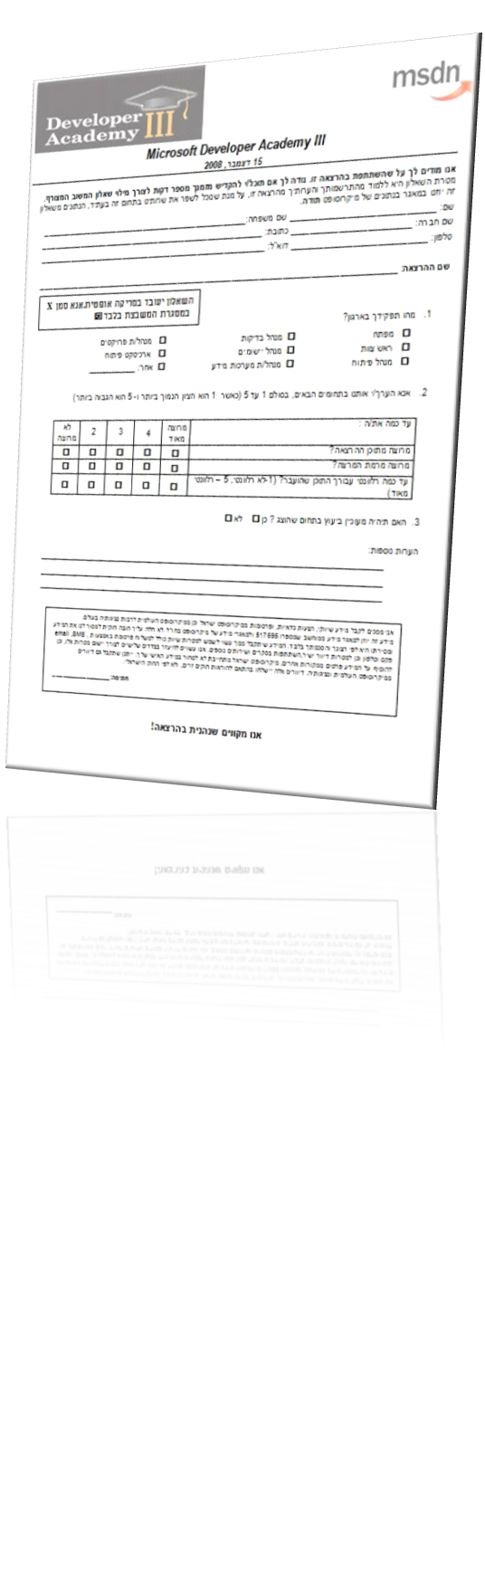


Slide 30

© 2008 Microsoft Corporation. All rights reserved. Microsoft, Windows, Windows Vista and other product names are or may be registered trademarks and/or trademarks in the U.S. and/or other countries.
The information herein is for informational purposes only and represents the current view of Microsoft Corporation as of the date of this presentation. Because Microsoft must respond to changing market conditions, it should not be interpreted to be a commitment on the part of Microsoft, and Microsoft cannot guarantee the accuracy of any information provided after the date of this presentation.
MICROSOFT MAKES NO WARRANTIES, EXPRESS, IMPLIED OR STATUTORY, AS TO THE INFORMATION IN THIS PRESENTATION.
Notes:
© 2007 Microsoft Corporation. All rights reserved. Microsoft, Windows, Windows Vista and other product names are or may be registered trademarks and/or trademarks in the U.S. and/or other countries.
The information herein is for informational purposes only and represents the current view of Microsoft Corporation as of the date of this presentation. Because Microsoft must respond to changing market conditions, it should not be interpreted to be a commitment on the part of Microsoft, and Microsoft cannot guarantee the accuracy of any information provided after the date of this presentation.
MICROSOFT MAKES NO WARRANTIES, EXPRESS, IMPLIED OR STATUTORY, AS TO THE INFORMATION IN THIS PRESENTATION.

